Slide 1
Gold price analysis
By Megha Kerur

Slide 2
Mentorness ML Internship
Time Series Analysis
Advanced Modeling
Trading Strategy Development
Market Sentiment Analysis
Statistical Analysis

Slide 3
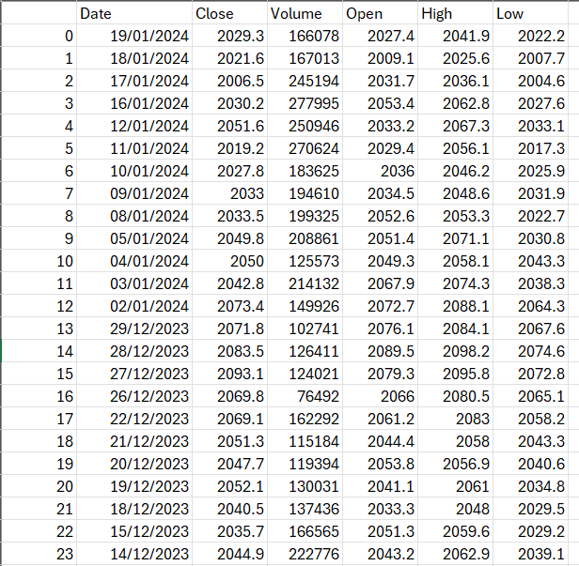
Date
Close
Volume
Open
High
Low

Slide 4
Dataset Description
Date: A unique identifier for each trading day.
Close: Closing price of gold on the respective date.
Volume: Gold trading volume on the corresponding date.
Open: Opening price of gold on the respective date.
High: The highest recorded price of gold during the trading day.
Low: The lowest price recorded for gold in the trading day.

Slide 5
1. Time Series Analysis
Explore historical trends and patterns in gold prices over the specified time period.
Identify seasonality, cyclicality, and any discernible long-term trends in the gold market.

Slide 6
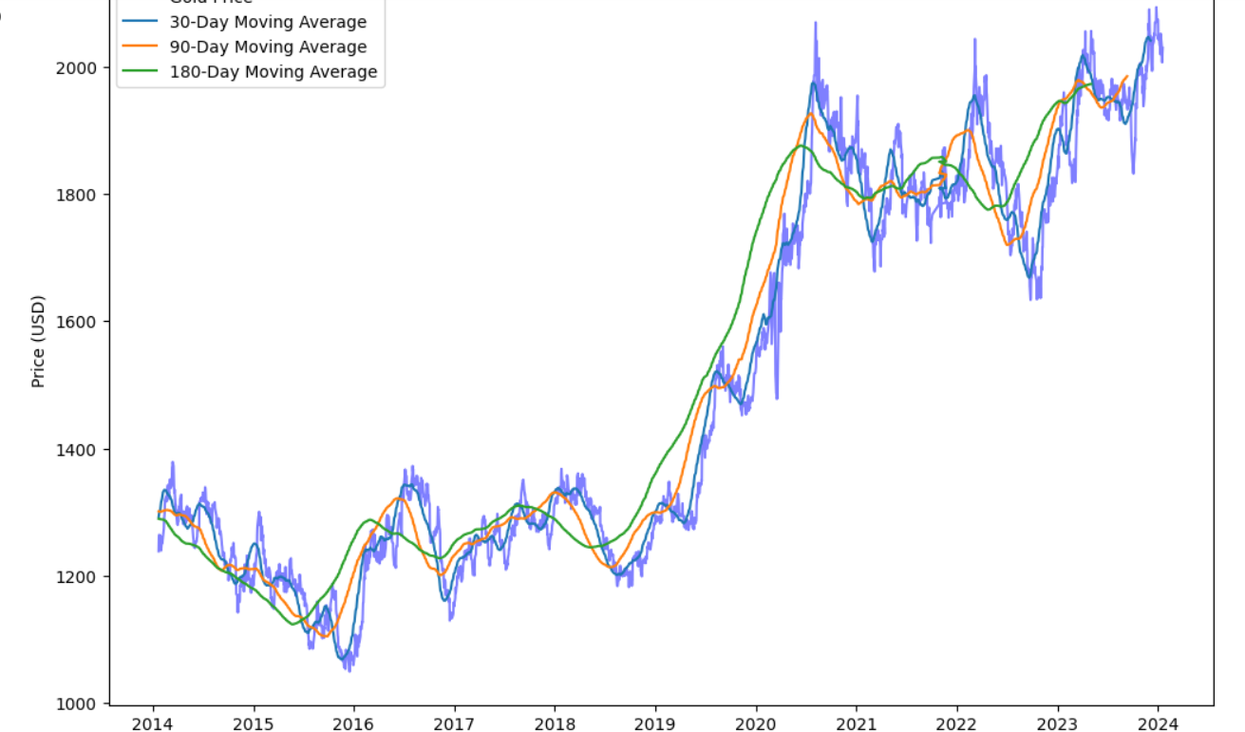
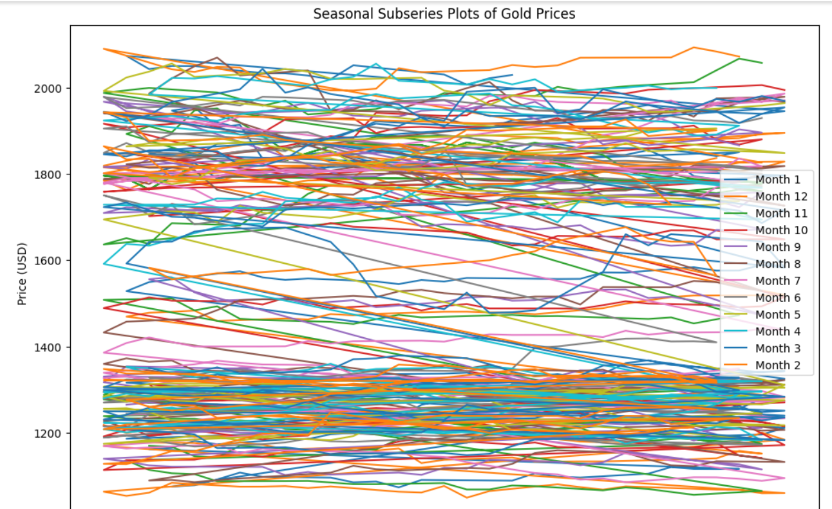
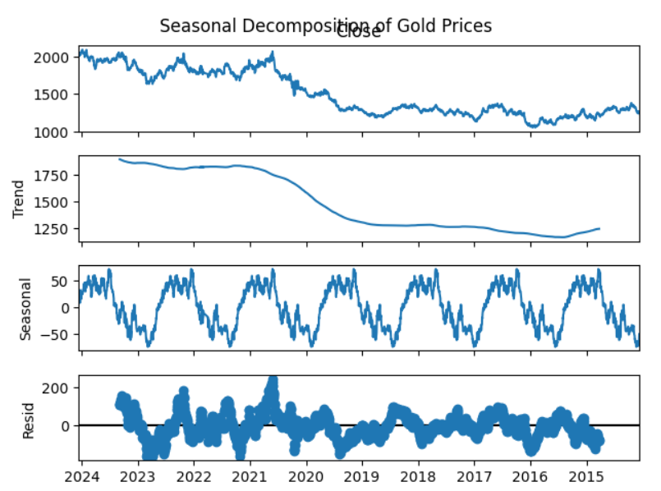
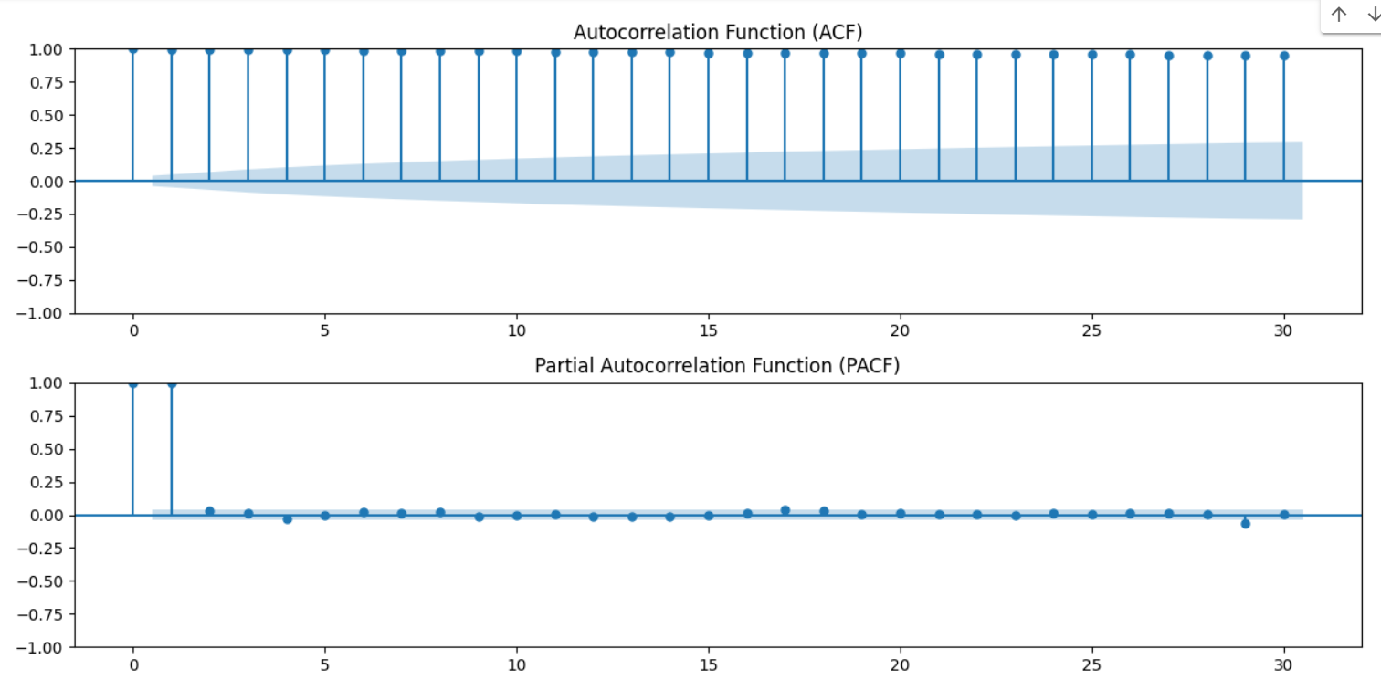
1. Time Series Analysis

Slide 7
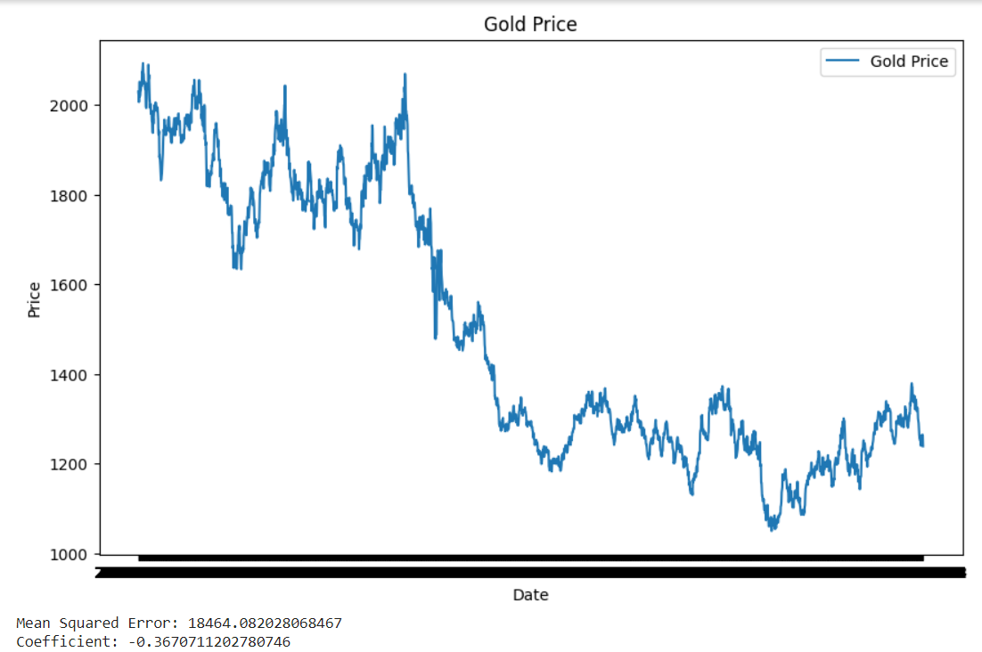
2- Advanced Modeling
Develop predictive models to forecast future gold prices based on historical data.
Evaluate and compare the performance of different forecasting algorithms

Slide 8
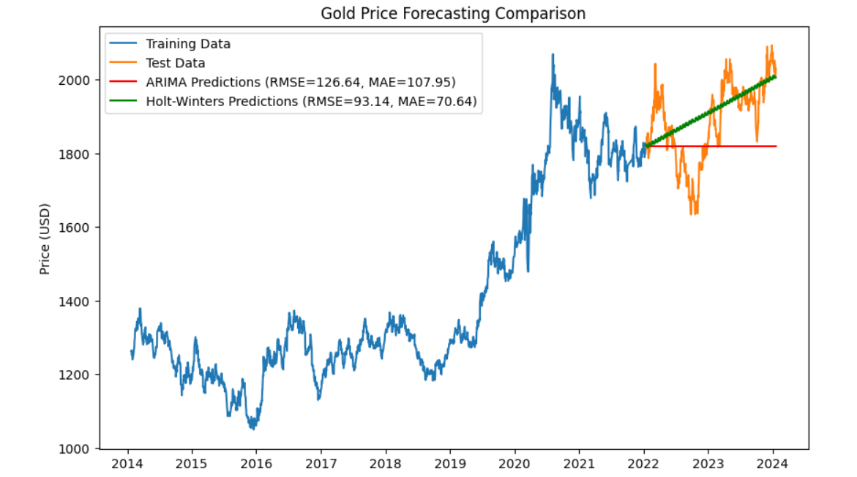
2- Advanced Modeling

Slide 9
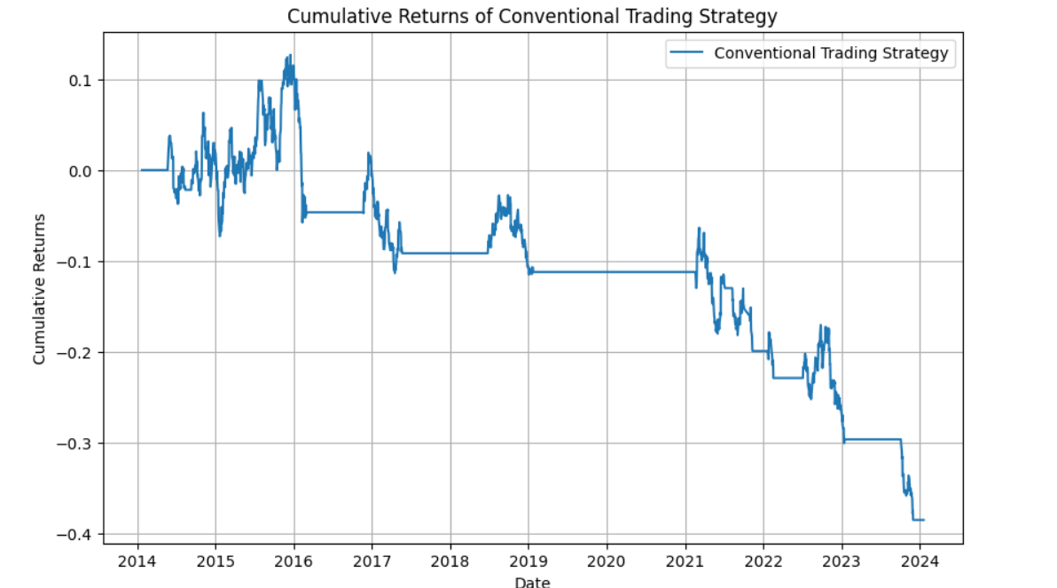
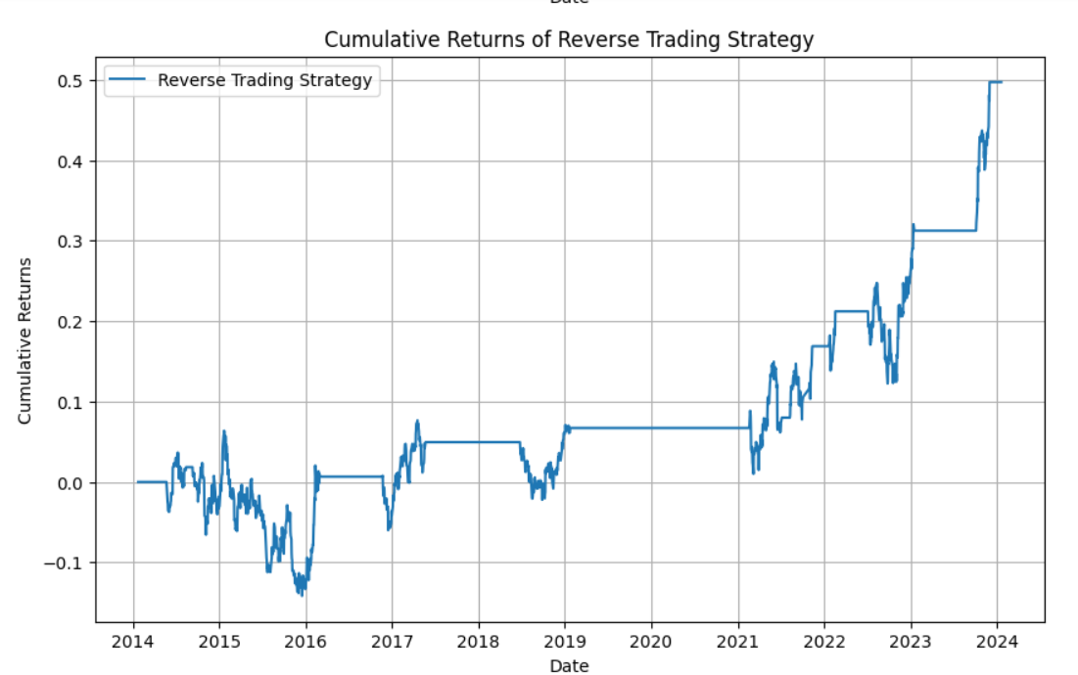
3. Trading Strategy Development
Formulate and back test trading strategies based on the provided price and volume information.
Explore the feasibility of reverse trading strategies for profit maximization.

Slide 10
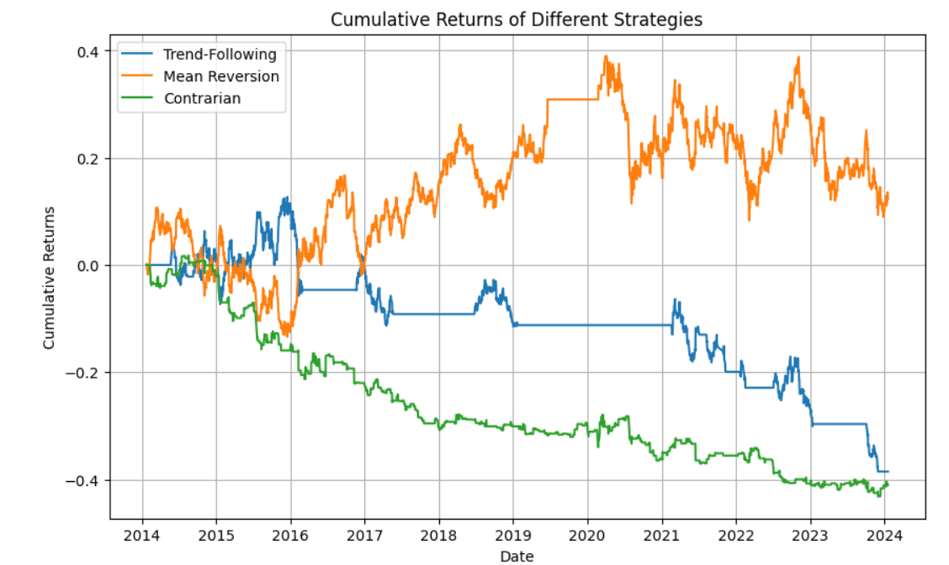
3. Trading Strategy Development

Slide 11
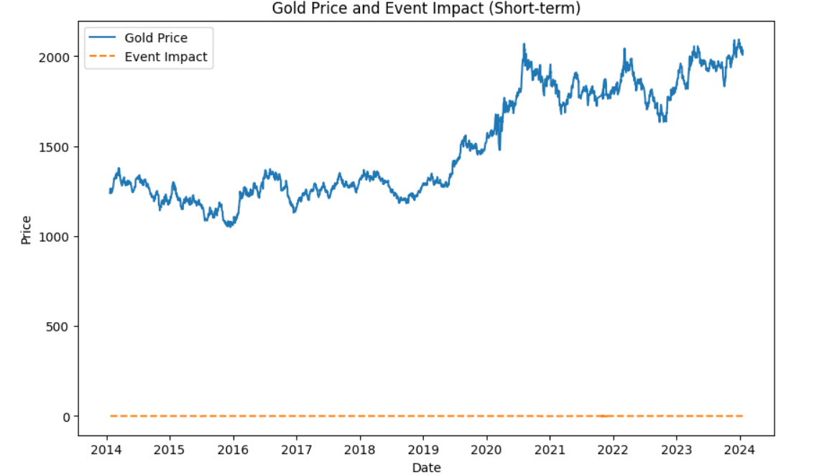
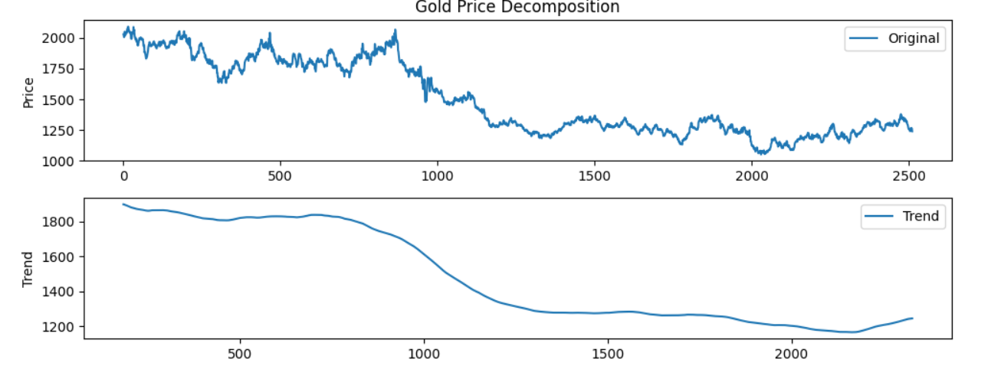
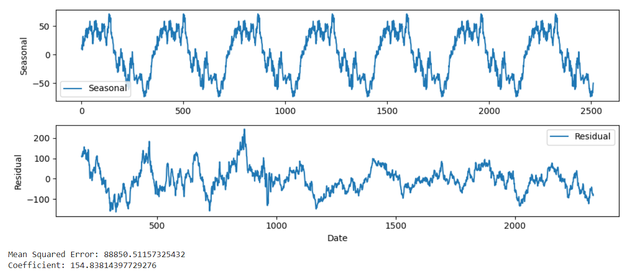
4. Market Sentiment Analysis

Slide 12
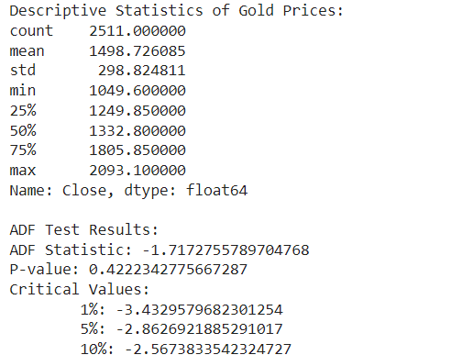
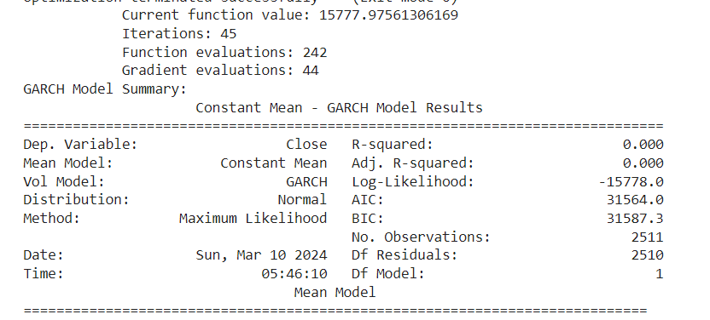
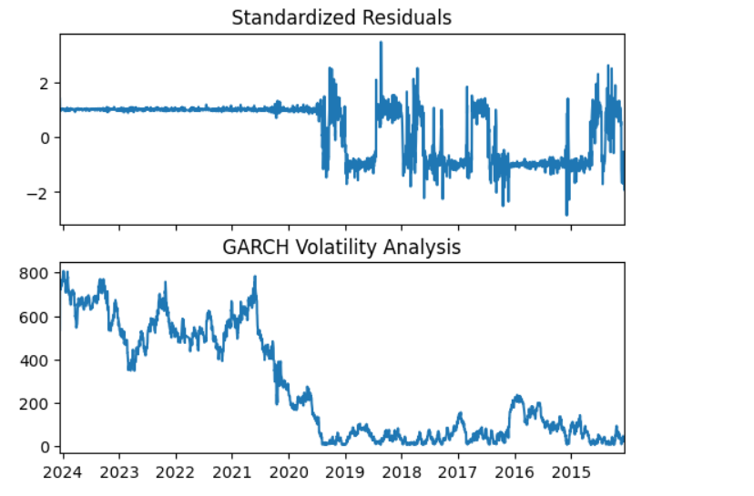
5. Statistical Analysis
Conduct statistical tests and analysis to gain insights into the characteristics of gold price movements.
Explore correlations with external factors and macroeconomic indicators.

Slide 13
THANK YOU

